Slide 1
EEE Lecture-17

Slide 2
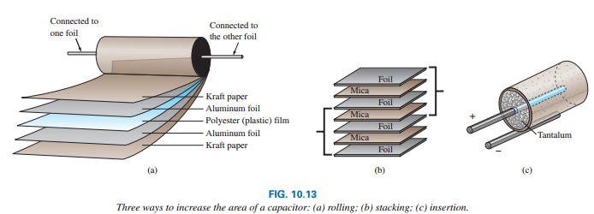
What factors influence which dielectric is used?
The following factors greatly influence which dielectric is used:
The level of capacitance desired
The resulting size
The requirements for packaging: rolling, stacking and insertion
Temperature sensitivity
Working voltage

Slide 3
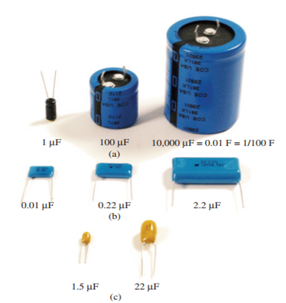

Types of Capacitors
In general, for the same type of construction and dielectric, the larger the required capacitance, the larger the physical size of the capacitor.
Generally there are 3 types:
Electrolytic capacitors
Film, polyester, foil, or Teflon capacitors
Ceramic capacitors (often called disc capacitors

Slide 4
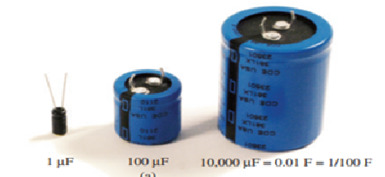
Electrolytic capacitors
The electrolytic capacitors are usually easy to identify by their shape.
Offer some of the highest capacitance values available, although their working voltage levels are limited.
Typical values range from 0.1 mF to 15,000 mF, with working voltages from 5 V to 450 V.

Slide 5
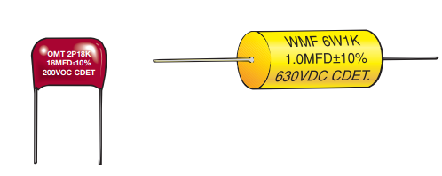
Film, polyester, foil or Teflon capacitors
Film, polyester, foil, polypropylene or Teflon capacitors packaged in a rolling or stacking process.
The resulting shape can be either round or rectangular, with two leads.
The typical range for such capacitors is 100pF to 10 mF
Working voltages can extend from a few volts to 2000 V, depending on the type of dielectric.

Slide 6
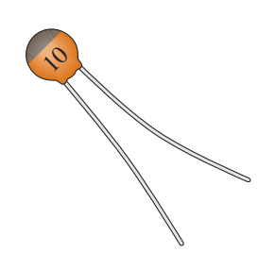
Ceramic capacitors
Ceramic capacitors (often called disc capacitors) use a ceramic dielectric to utilize the excellent permittivity values and high working voltages associated with a number of ceramic materials.
Stacking can also be applied for packaging.

Slide 7
10.4 Capacitors Leakage Current
Up to this point, we have assumed that the flow of electrons will occur in a dielectric only when the breakdown voltage is reached. This is the ideal case.
In reality, however, dielectrics are not perfect insulators, and they do carry a few free electrons in their atomic structure.
There are free electrons in every dielectric due to the existence of impurities in the dielectric.
When a voltage is applied across the plates of a capacitor, a leakage current due to the those free electrons flows from one plate to the other.
The current is usually so small, however, that it can be neglected for most practical applications.

Slide 8
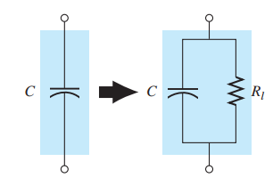
10.4 Capacitors Leakage Current
The availability of free electrons which causes leakage current flow is represented by a large internal resistor in parallel with the capacitor as shown in the following Fig. 10.21(a).
If we apply 10 V across a capacitor with an internal resistance of 1000MΩ, the leakage current will be 0.01 mA—a level that can be ignored for most applications.

Slide 9
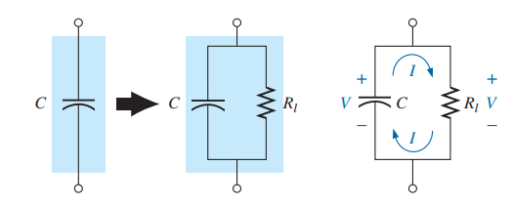
10.4 Capacitors Leakage Current
If the capacitors to sit in a charged state for long periods of time, the capacitor is totally discharged gradually.
Capacitors such as the electrolytic that have high leakage currents (a leakage resistance of 0.5 M is typical).
Ceramic, tantalum, and mica capacitors typically have unlimited life expectancy due to leakage resistances in excess of 1000 MΩ.
Thin-film capacitors have lower levels of leakage resistances.

Slide 10
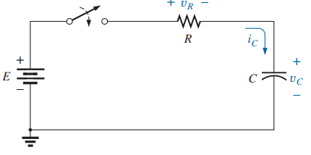
10.7 Transients in Capacitive network: Charging Phase
The placement of charge on the plates of a capacitor does not occur instantaneously. Instead, it occurs over a period of time determined by the components of the network.
The charging phase, the phase during which charge is deposited on the plates, can be described by reviewing the response of the simple series circuit in Fig. 10.4.
The instant the switch is closed, electrons are drawn from the top plate and deposited on the bottom plate by the battery, resulting in a net positive charge on the top plate and a negative charge on the bottom plate.

Slide 11
10.7 Transients in Capacitive network: Charging Phase
The transfer of electrons is very rapid at first, then slowing down as the potential across the capacitor approaches the applied voltage of the battery.
Eventually, when the voltage across the capacitor equals the battery voltage, the transfer of electrons will stop and the plates will have a net charge determined by Q = CV_{C} = CE.
This period of time during which charge is being deposited on the plates is called the transient period.

Slide 12
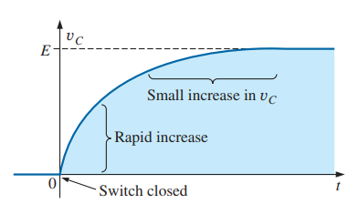
Transients in Capacitive network: Charging Phase
As shown in Fig. 10.27, the voltage across the capacitor is zero volts when the switch is closed (t = 0s).
It then builds up very quickly at first since charge is being deposited at a very high rate of speed at the beginning.
As time passes, the charge is deposited at a slower rate, and the change in voltage changes to drop off.
The voltage continues to grow, but at a much slower rate. Eventually, as the voltage across the plates approaches the applied voltage, hence, it is in a steady state as the transient phase has passed.

Slide 13
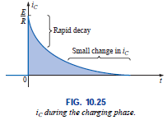
10.7 Transients in Capacitive network: Charging Phase
Note the rapid decay in current level, revealing that the amount of charge deposited on the plates per unit time is rapidly decaying also.
Since the voltage across the plates is directly related to the charge on the plates by v_{C} = q/C, the rapid rate with which charge is initially deposited on the plates will result in a rapid increase in v_{C}.
Obviously, as the rate of flow of charge (I) decreases, the rate of change in voltage will decreases. Eventually, the flow of charge will stop, the current I will be zero.

Slide 14
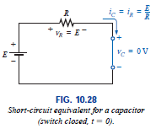
10.7 Transients in Capacitive network: Charging Phase
Looking back at the instant the switch is closed, we can also assume that a capacitor behaves as a short circuit the moment the switch is closed in a dc charging network, as shown in Fig. 10.28.
The current i = i_{C} = i_{R} = E/R, and the voltage
v_{C} = E - v_{R}
= E - i_{R}R
= E - (E/R)R
= E - E = 0 V [at t = 0 s]

Slide 15
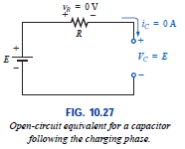
10.7 Transients in Capacitive network: Charging Phase
When the voltage across the capacitor is equal to the source voltage, the capacitor takes on the characteristics of an open circuit:
As demonstrated in Fig. 10.27, the voltage across the capacitor is the source voltage since i = i_{C} = i_{R} = 0 A and v_{R} = i_{R}R = (0)R = 0 V. For all future analysis:
A capacitor can be replaced by an open-circuit equivalent once the charging phase in a dc network has passed.

Slide 16
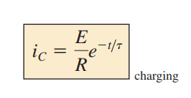
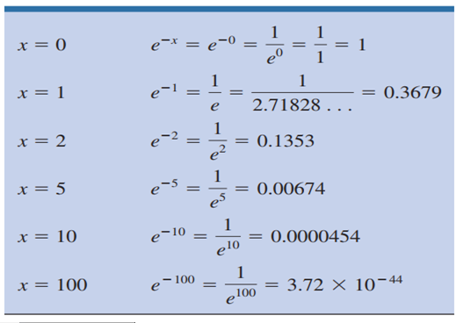
10.7 Transients in Capacitive network: Charging Phase
Through the use of calculus, the following mathematical equation for the charging current i_{C} can be obtained:
Where e^{-x} is an exponential function that decreases with time.

Slide 17




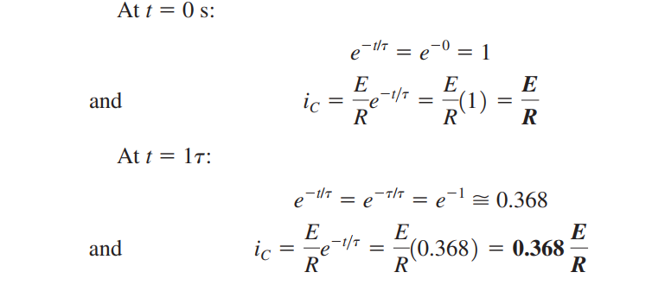
10.7 Charging Phase

Slide 18
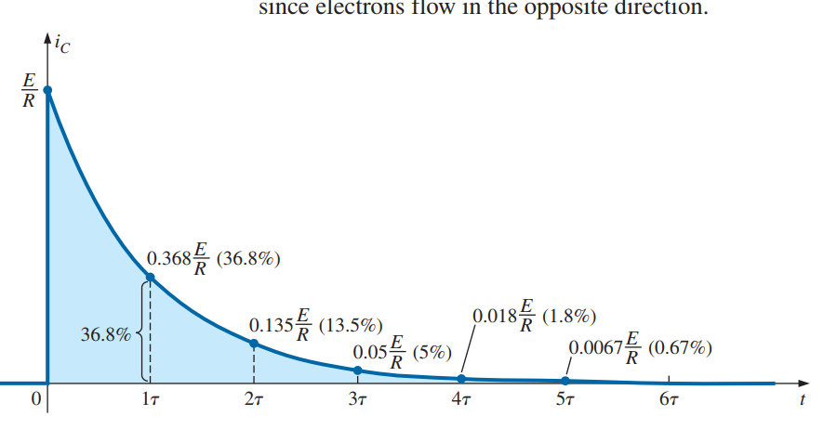
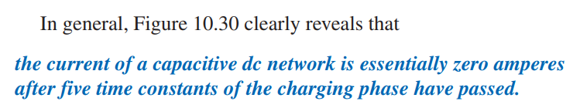

Slide 19
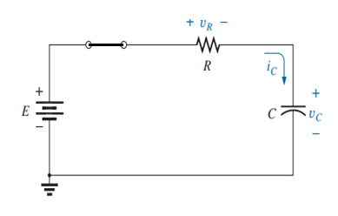
10.7 Charging Phase
v_{C} = E - v_{R}
= E - i_{R}R
= E – i_{C}R
= E – (E/R. e^{-t/τ}).R
v_{C} = E (1- e^{-t/τ})

Slide 20

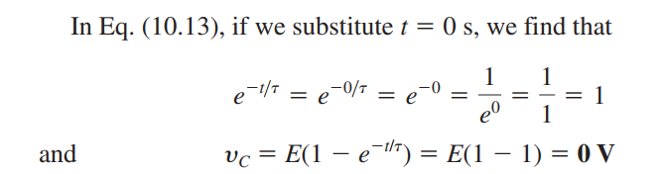
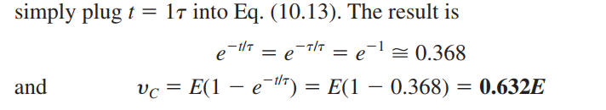
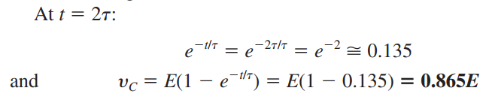
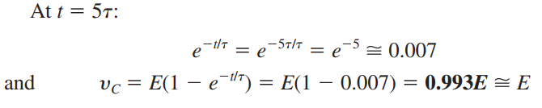
The voltage across the capacitor during charging phase, v_{c} is calculated as follows:

Slide 21
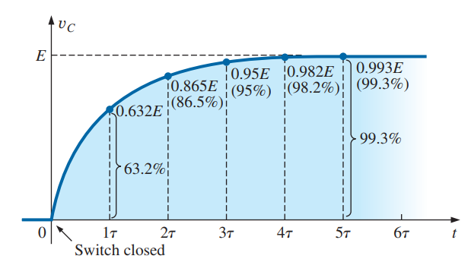
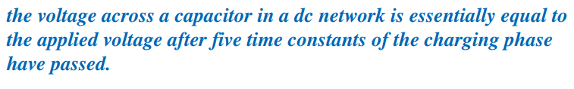

Slide 22
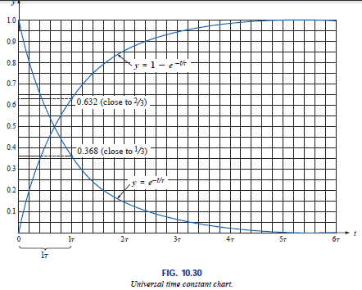
10.7 Transients in Capacitive network: Charging Phase

Slide 23
10.7 Transients in Capacitive network: Charging Phase
The time constant τ will always have some value because some resistance (R) is always present in a capacitive network.
In some cases, the value of τ may be very small, but five times that value of τ, no matter how small, must therefore always exist; it cannot be zero.
Generally, R has a constant value, the larger the capacitance (C), the larger the time constant τ, and the longer it will take the voltage across the capacitor to reach the applied value.
The result is the following very important conclusion: The voltage across a capacitor cannot change instantaneously.

Slide 24
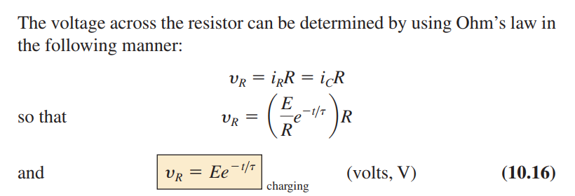
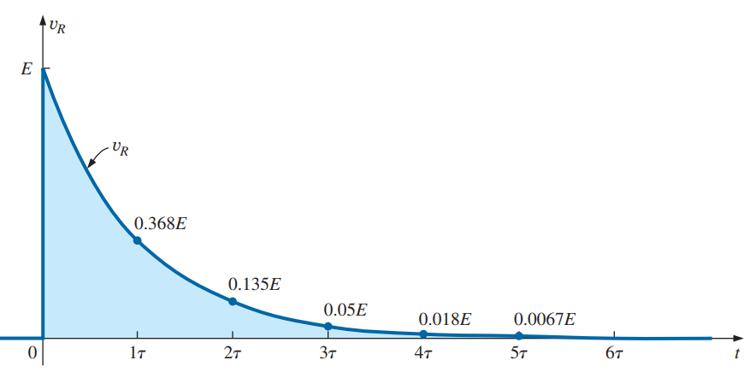
10.7 Transients in Capacitive network: Charging Phase

Slide 25
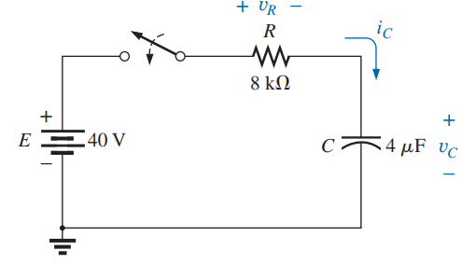
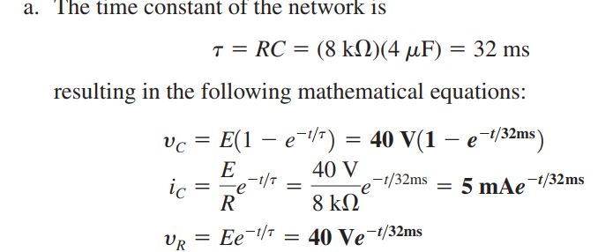

Slide 26

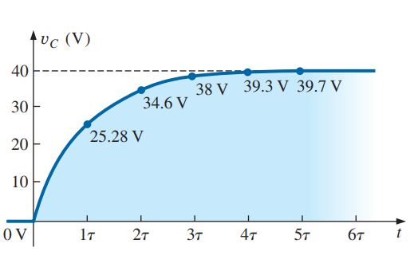
When t = 0s
Vc = 40x(1-e⁰)=0
When t = 1τ
Vc = 40x(1-e⁻¹)
=40x(1-0.3679)
=40x0.6321=25.28V
When t = 2τ
Vc = 40x(1-e⁻²)
=40x(1-0.1353)
=40x0.8647=34.6V

Slide 27
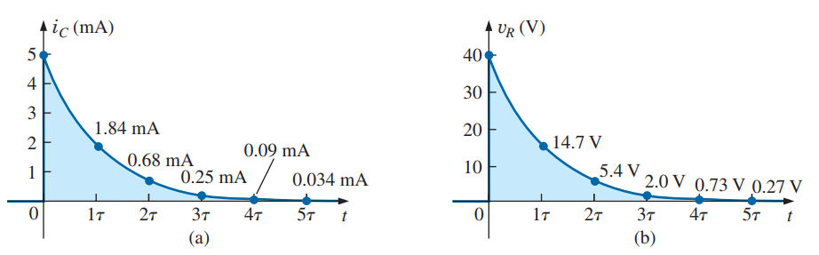



Slide 28
Thank You

